Slide 1
The smart bus system based on waiting time estimation and special passenger tracking
Group members:
Emmanuel Sedicol
Jingwen Jiang
Jianing Tan
Instructor: Dr. Kumar Yelamarthi
Dr. Frank Walsh

Slide 2

Objectives
Problem statement
Rationale
Previous work
System structure
Methods & Results
Evaluation
Limitations
Future work

Slide 3

Problem
Statement
Problems and demands around bus:
Unknowing the specific position of bus, people waste lots of time waiting at bus stops.
There are demands that people want to know whether the bus is full or not and whether there is an empty seat on bus.
As for school bus, parents want to know if their children miss the bus or not.
Waiting time evaluation and empty seats detection system
Smart Bus System:
Parental Monitor Application

Slide 4

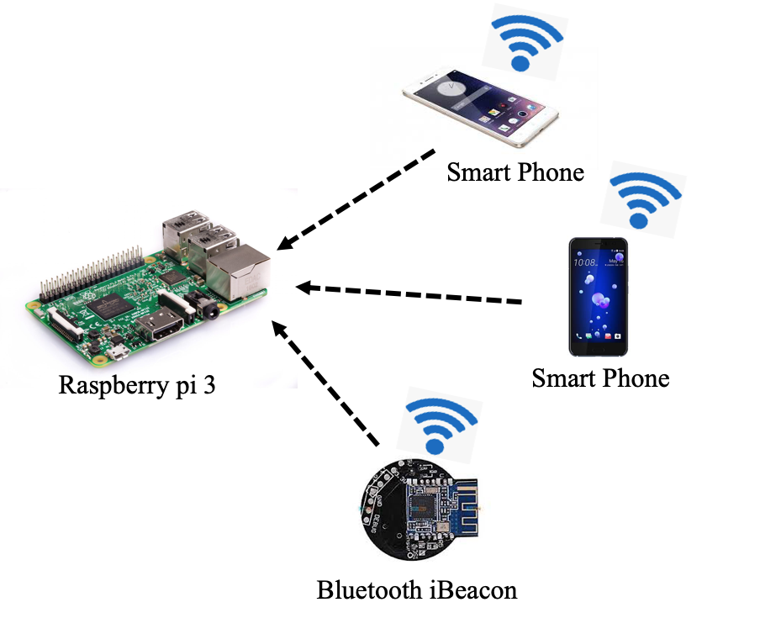
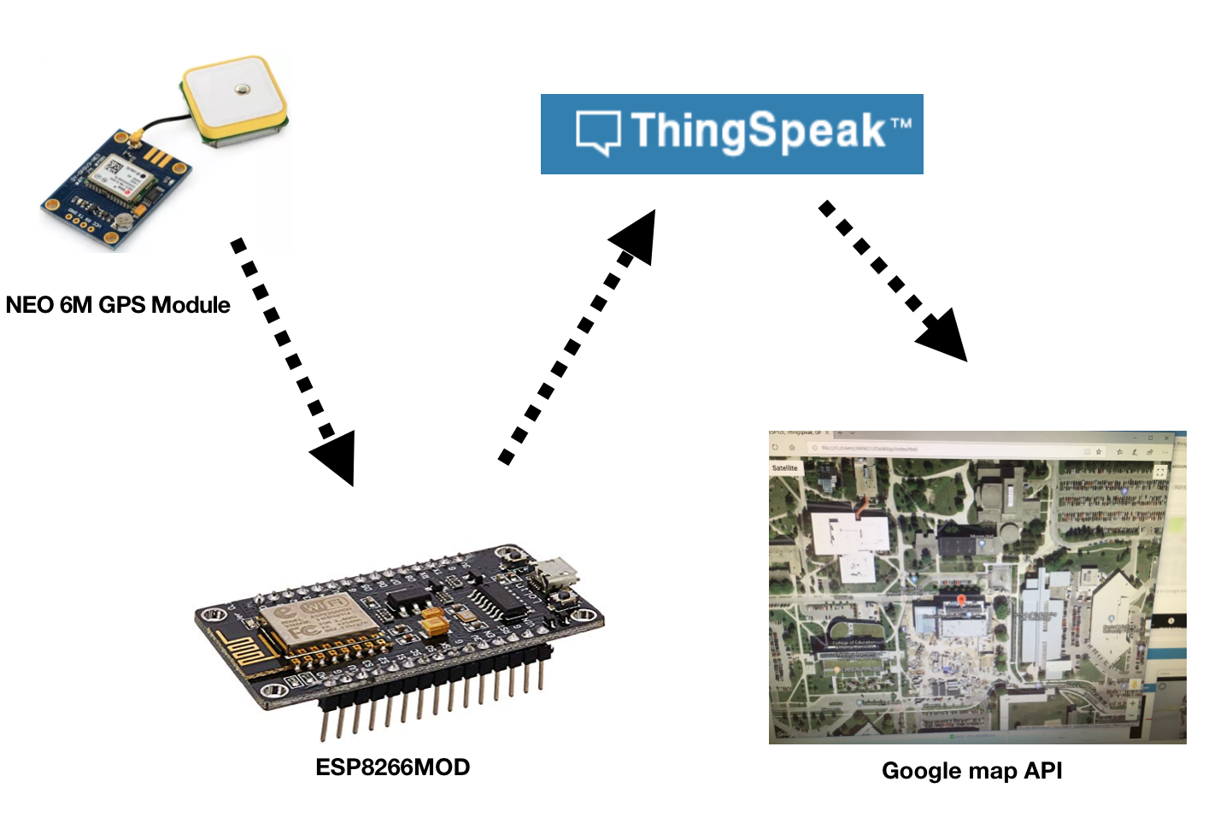
Rationale
Waiting time evaluation system and empty seats detection system:
Using GPS module to collect position and speed of bus.
distance/speed=time
Regarding raspberry pi as a bluetooth scanner to detect the number of bluetooth signals from smart phone(number of passenger).
the number of seats - the number of passengers
=the number of empty seats

Slide 5


Rationale
Parental Monitor Application:
Every bluetooth beacon has an unique address and store address in Database.
Using raspberry pi as a bluetooth scanner to detect the specific beacon.
Send text messages using nexmo package
(need to make nexmo account online))

Slide 6

Previous work
To build a bus tracking system
GPS module and GSM module to establish a bus tracking system(Lee, Tewolde, and Kwon, 2014),
Bluetooth for the bus tracking (A.Kumar, 2017).
Number of people measurement in public place
RFID to track bus cards (V. Kostakos 2010).
Single camera fixed at an overhead position(T.Wang, 2016)
BLE to measure the amounts of people.(P.Mathur, 2016)

Slide 7
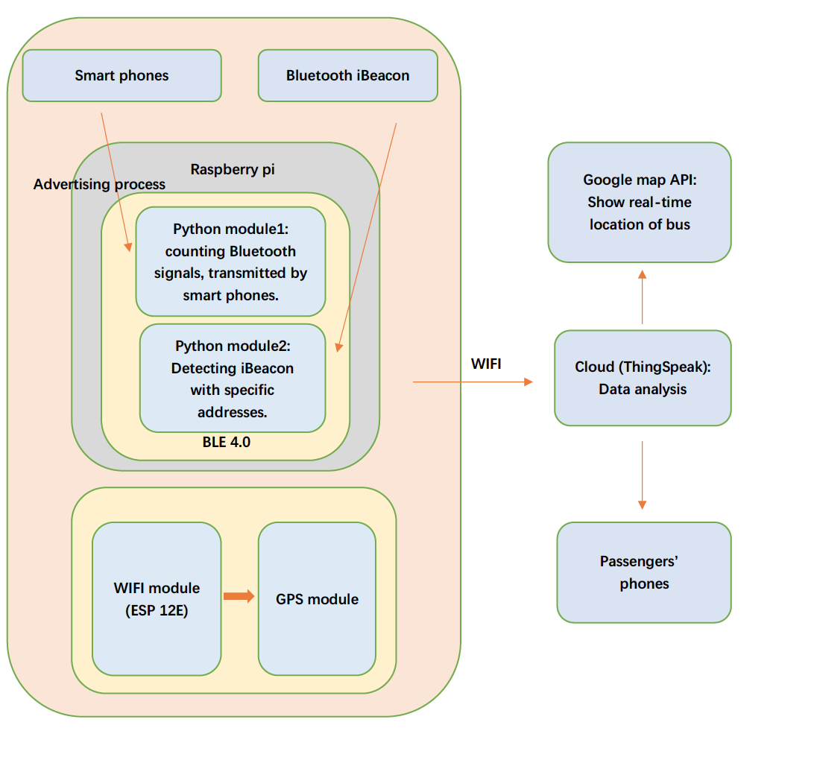

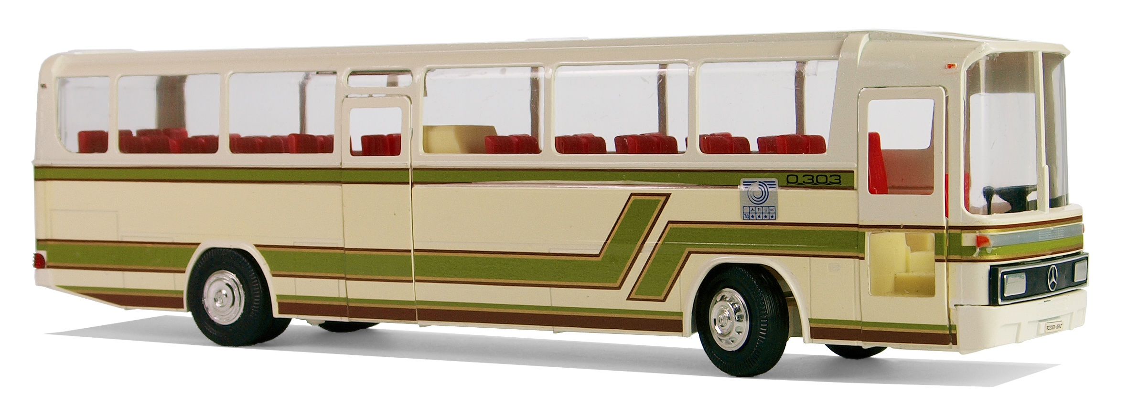
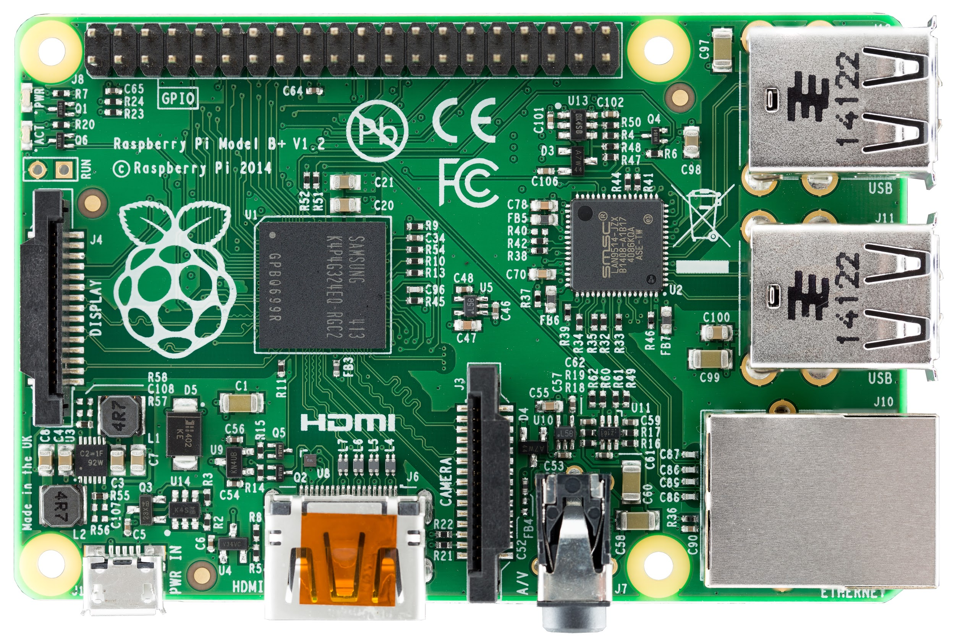


System
Structure

Slide 8
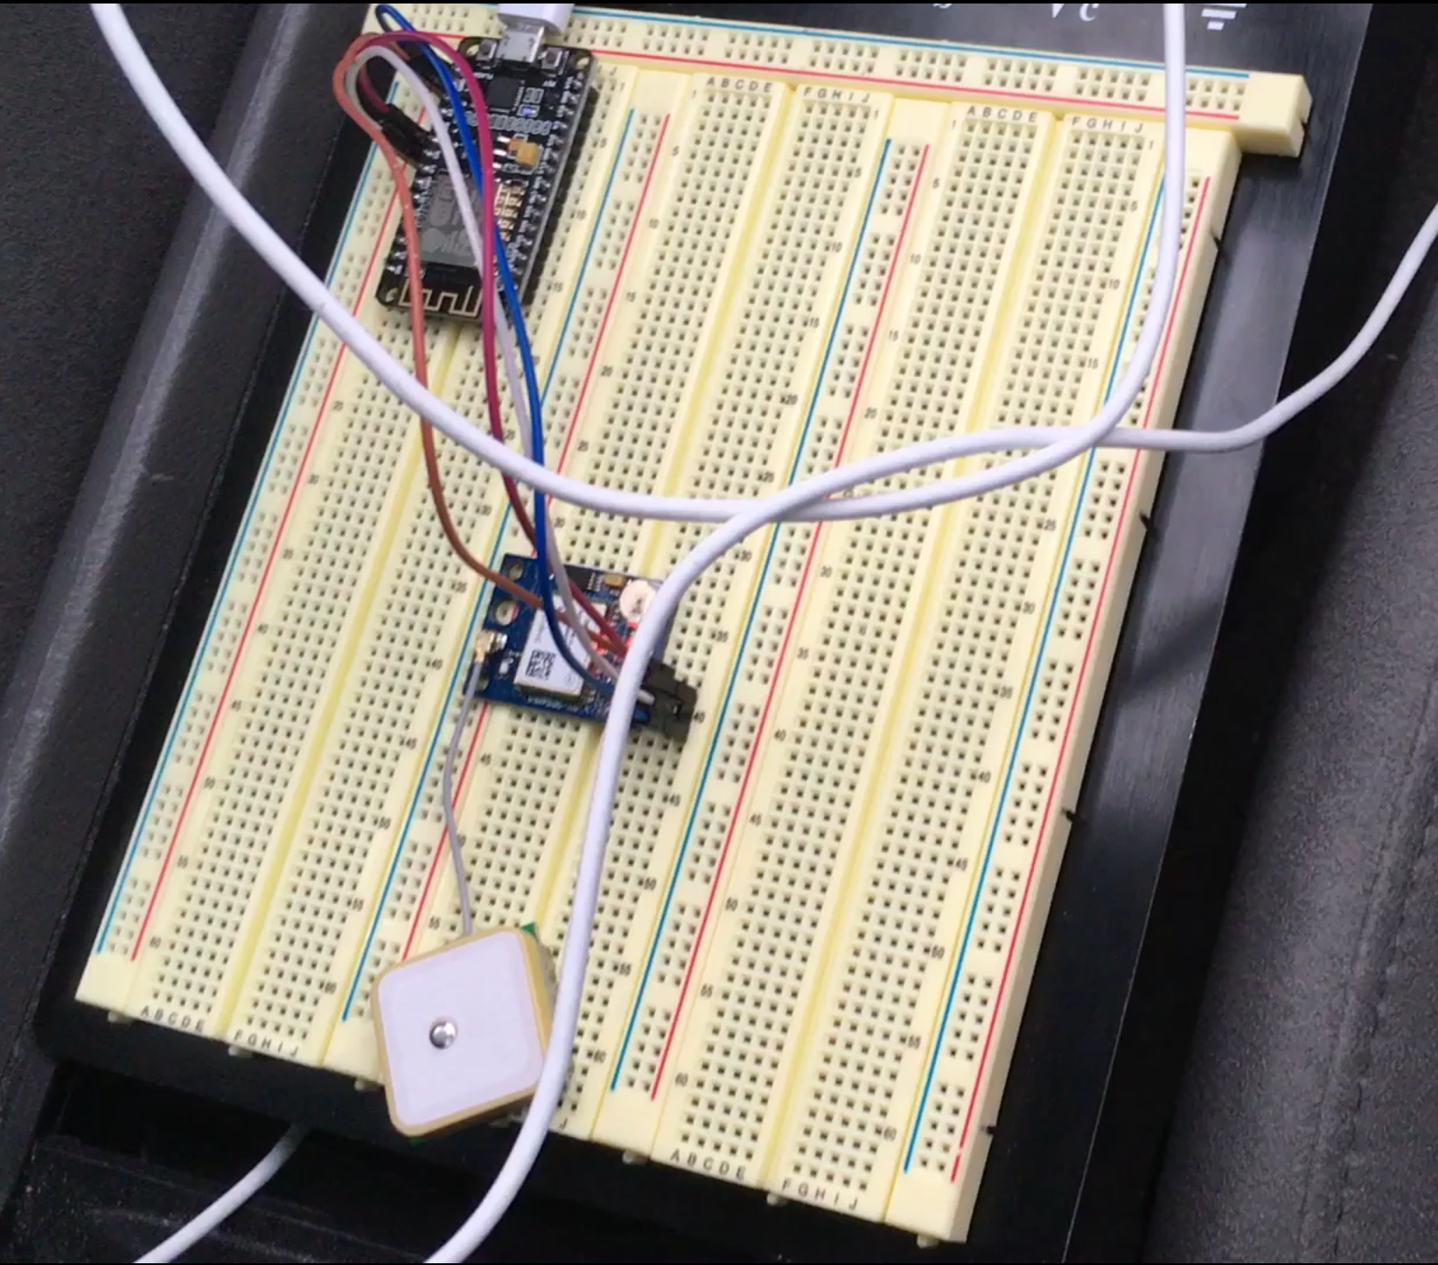
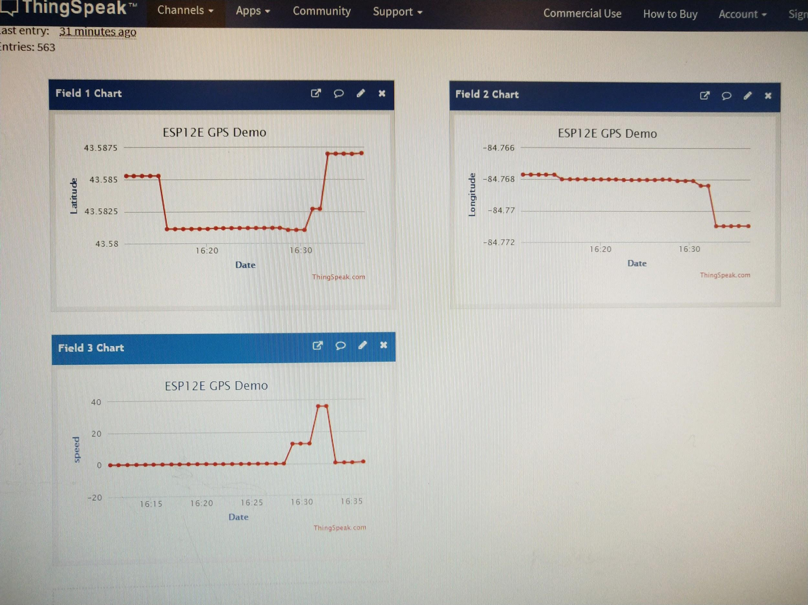
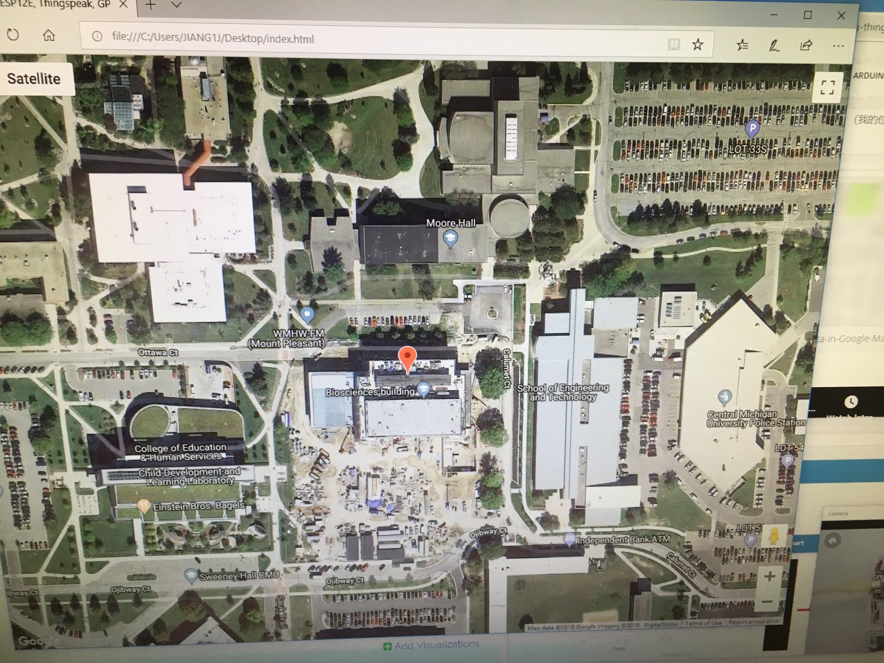
Methods
&
Results
GPS tracking
Connected the GPS module to the wifi module and wrote code for it.
ThingSpeak showed the real-time data.
Google map
For GPS tracking system, we got latitude, longitude as well as the speed successfully from GPS module, and sent them to ThingSpeak (cloud). The location of car can be displayed by using Google map API key.

Slide 9
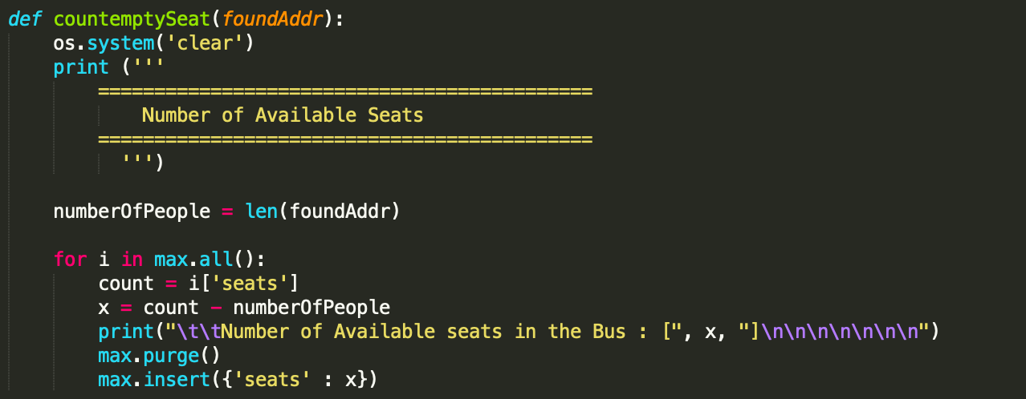
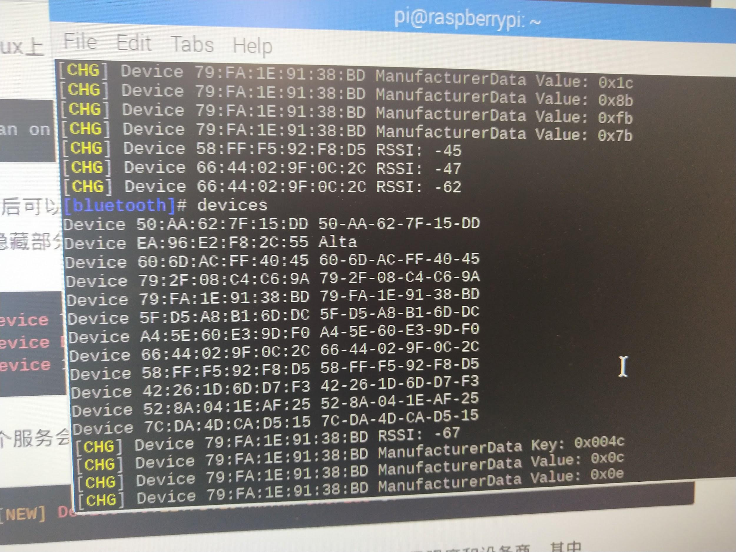
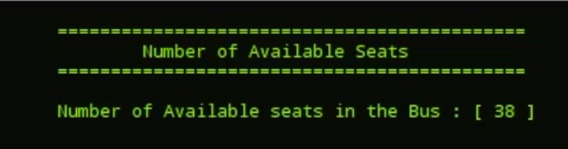
Methods
&
Results
empty seats counting
Python code to count the number of seats assuming the seats number is 40.
Set up BLE 4.0 on raspberry pi using python language. A list of devices and their addresses showed on the screen and it represented the number of smartphone nearby.
After running the code, we opened 2 bluetooth devices which means there were 2 passengers on the bus and got the number of empty seats is 38.

Slide 10
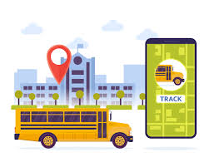


Methods
&
Results
We need to install the following:
sudo apt-get install bluetooth
pip3 install nexmo
pip3 install tinydb
NB: Children first need to register
Parental Monitoring Application
Link : https://github.com/Esedicol

Slide 11
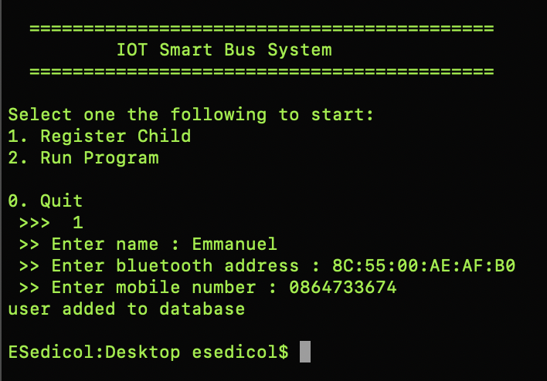
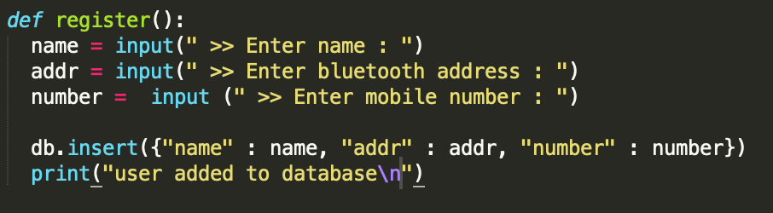
Register Child
- using python3 we wrote a python script to ask for user input on screen
- we then inserted that data onto the database

Slide 12
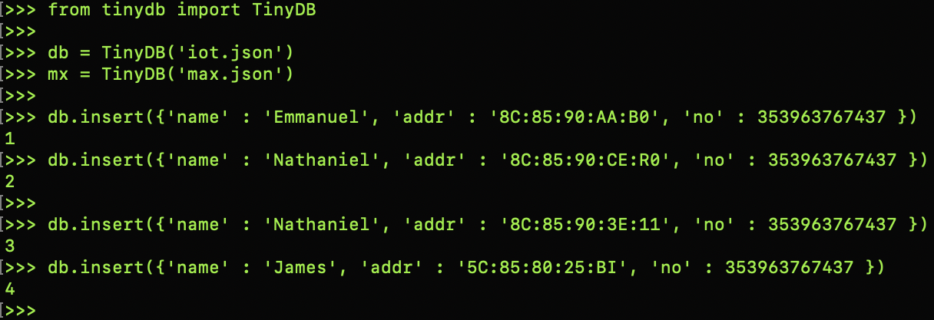
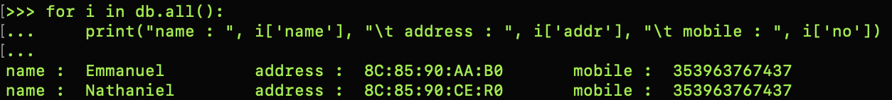
Database
Database Format:
since mongodb isn’t available due to version error, our second choice is called TinyDB.
The database will contain:
children name
children’s bluetooth address
contact number of guardian
Accesing Database:

Slide 13
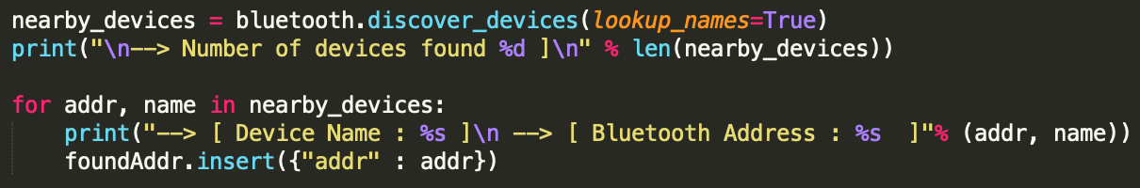
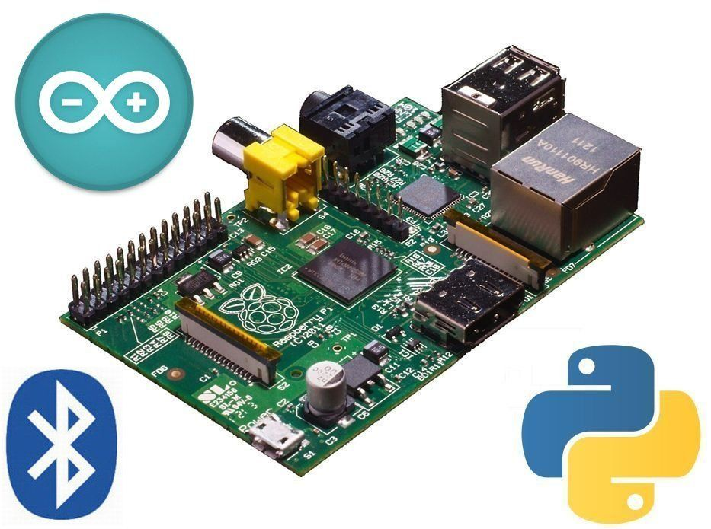
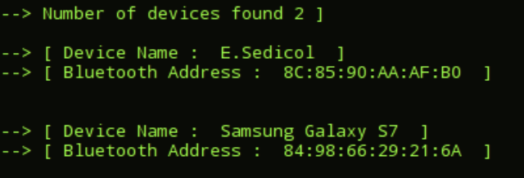
Bluetooth detection code:
Screen output:
Bluetooth Detection
we used the python3 bluetooth module to detect available devices and store that in the database.

Slide 14
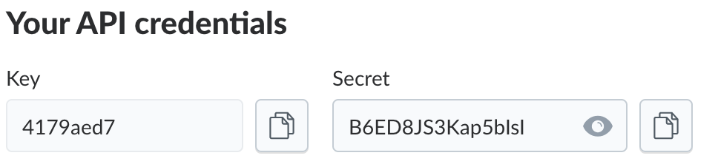
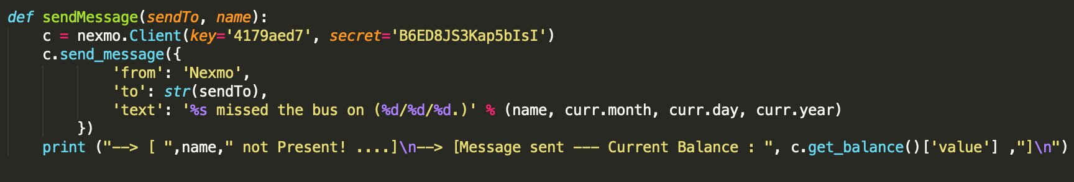
Nexmo
We had errors when using nexmo so we decided to use a simpler API for sending text messages called nexmo.
nexmo (not free):
text
call
email
Python Script:
python method will take in two parameters, ‘sendTo’ and ‘name’
‘sendTo’ is the mobile number of parents
‘name’ used to define which children we are refering to

Slide 15
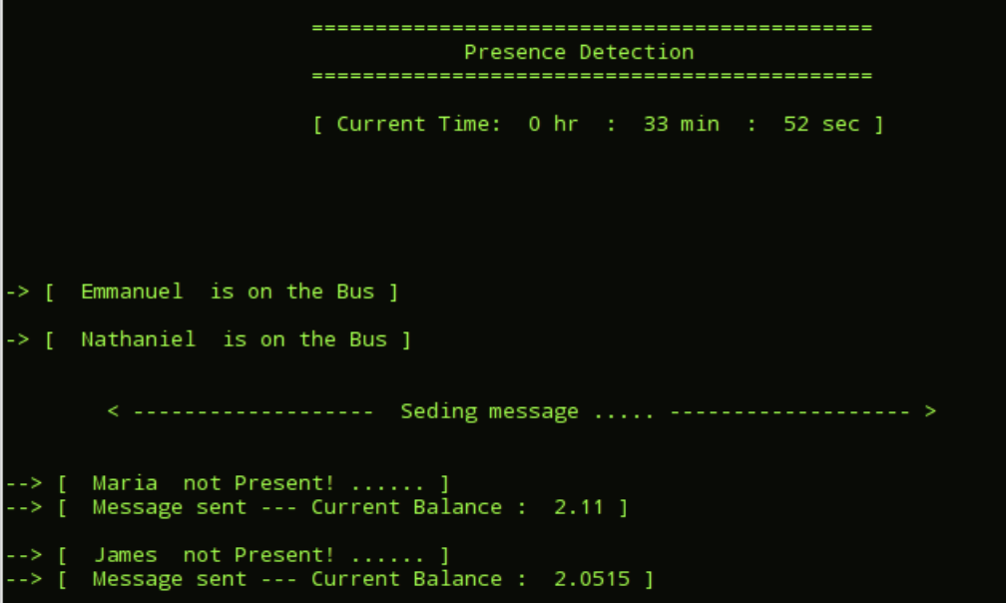
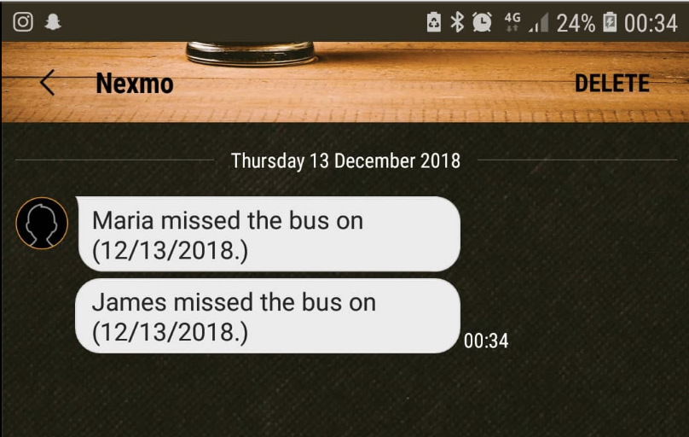
Result
Presence detection and sending of alert messages
This is the screen output of our pressence detection:
displays whos on the bus
displays whos not on the bus
displays current time
displays current balance

Slide 16

Evaluation
Waiting time evaluation system
1 | Send data to cloud
2 | count bluetooth signals successfully
3 | Calculate empty seats and waiting time
4 | Display real-time position though Google map API
Parental Monitor Application
1 | Detect and record the presence or absence of a child
2 | Analysis on the cloud
3 | Send text to parents whether their children missed bus
4 | Get time table from cloud and send to parents

Slide 17
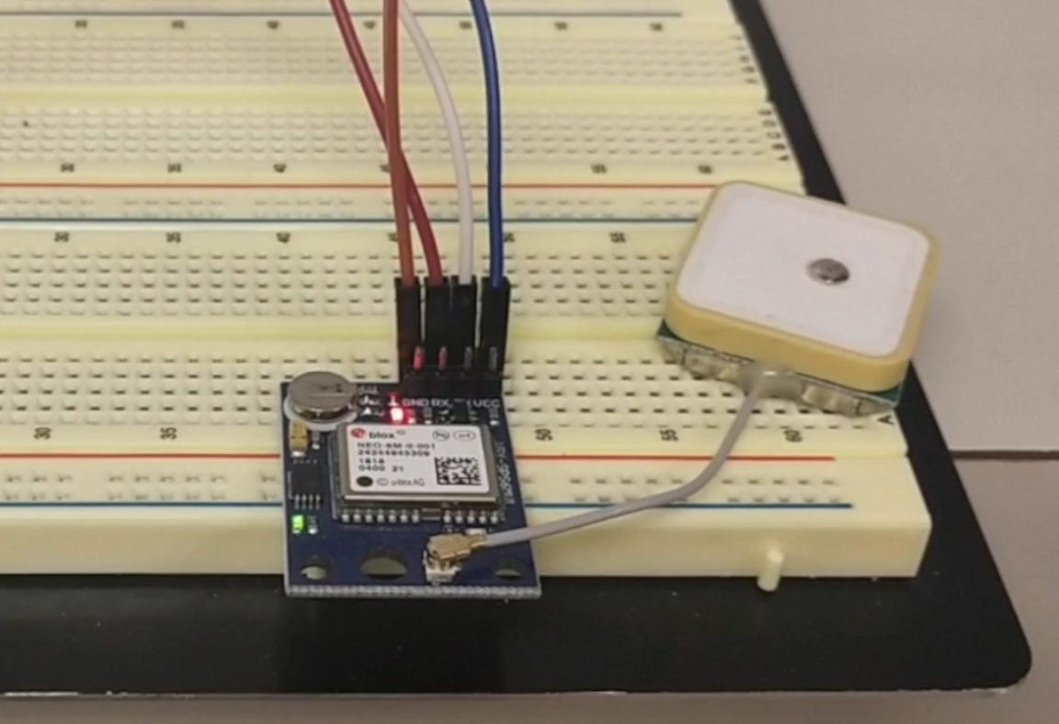
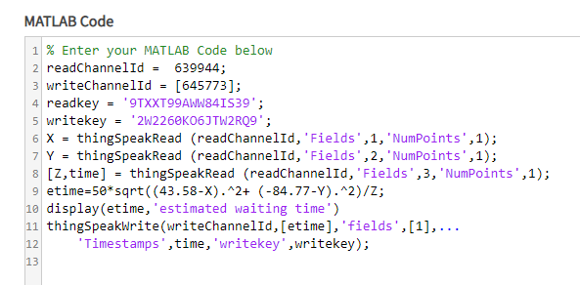
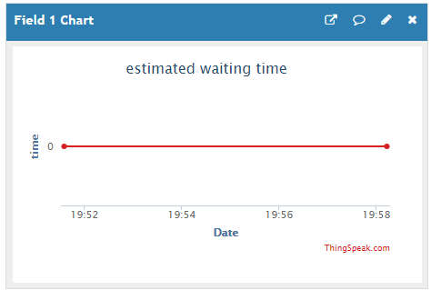
Limitations
1. During the experiment, we found that the GPS module is not stable enough. In addition, we have to wait a few minutes before the NEO 6m ( GPS module) works.
2. The distance is the straight-line distance which is not the real distance.
3. The real distance of every degree changes when the latitude changes.

Slide 18
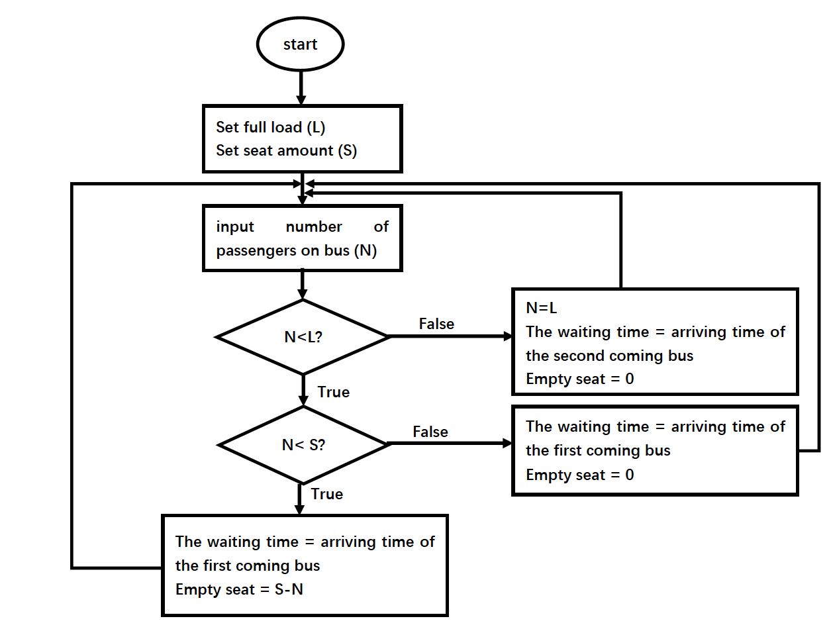

Future work
1. Complete the follwing analysis on the cloud.
2. The way to power this system.
3. Select the best place on bus to install the components.

Slide 19


